Slide 2
Chapter 4
Models of Cloud Computing

Slide 3
Learning Outcomes
At the end of the session you will be able to:
Comprehend service models of cloud computing
Describe cloud services provided by SaaS, IaaS, and PaaS
Describe cloud stack and cloud storage
Differentiate various deployment models
List the benefits of service models

Slide 4
Introduction
The cloud computing system is composed of a set of layers upon which distributed applications are built. These layers include infrastructure, platform, and software. Based on these three layers, we can devise three cloud computing models are devised.
Infrastructure as a Service (IaaS) model provides infrastructure-related services and is responsible for handling hardware-related issues, power, and cool management in data centers.
Platform as a Service (PaaS) model takes the responsibilities of operating system, database management, server, and programming language.
Software as a Service (SaaS) model handles software-related issues and provides amenities to the cloud users.

Slide 5
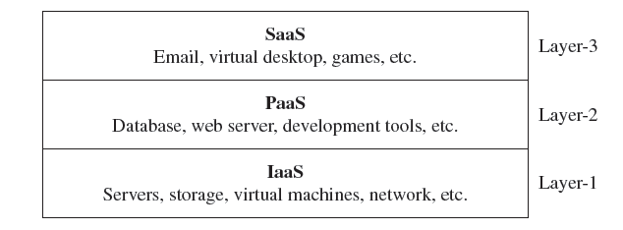
Cloud Service Models
On the basis of allocation of resources, cloud computing offers their services.
1. Bottom layer (layer-1)—IaaS—accommodates memory, CPU, and additional hardware resources
2. Middle layer (layer-2)—PaaS—accommodates diverse settings for consumer-particular services
3. Top layer (layer-3)—SaaS—cloud
service accessing occurs via web
browsers and web services

Slide 6
Software as a Service
Software as a Service (SaaS) is a software distribution model in which applications are hosted by a vendor or service provider and made available to customers over the Internet.
National Institute of Standards and Technologies (NIST) defines cloud SaaS as
follows:
“The capability provided to the consumer is to use the provider’s applications running on a cloud infrastructure. The applications are accessible from various client devices through either a thin client interface, such as a web browser (e.g., web-based email), or a program interface. The consumer does not manage or control the underlying cloud infrastructure including network, servers, operating systems, storage, or even individual application capabilities, with the possible exception of limited user-specific application configuration settings”.

Slide 7
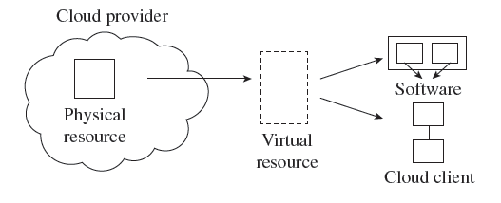
Software as a Service
Some of the applications of SaaS are:
Complaint resolution system
Employee management system
Attendance resolutions system
E-police, E-court
Municipal maintenance
Water board, billing, payment systems
District management solutions
Service desk

Slide 8
Importance of SaaS
The following are some of the reasons SaaS services are required:
1. Straightforward expenses are nil.
2. You only need a web browser to access the application. It doesn’t require other hardware purchase or software installation.
3. It provides quick operation service.
4. SaaS is extremely scalable.
5. Since the source code is the same for each customer, it is a multi-tenant design that makes it extremely proficient.
6. SaaS can endure every demand, because of easy arrangement; this is usually not simple with conventional applications.
7. Any noble technical modernization is effortlessly incorporated by the supplier that is accessible to all subscribers because, usually, all the consumers use a similar code base.

Slide 9
Platform as a Service
The Platform as a Service (PaaS) model makes all of the facilities required to support the complete life cycle of building and delivering web applications and services available from the Internet.
National Institute of Standards and Technologies (NIST) defines cloud PaaS as follows:
“The capability provided to the consumer is to deploy onto the cloud infrastructure consumer created or acquired applications created using programming languages, libraries, services, and tools supported by the provider. The consumer does not manage or control the underlying cloud infrastructure including network, servers, operating systems, or storage, but has control over the deployed applications and possibly configuration settings for the application-hosting environment”.

Slide 10
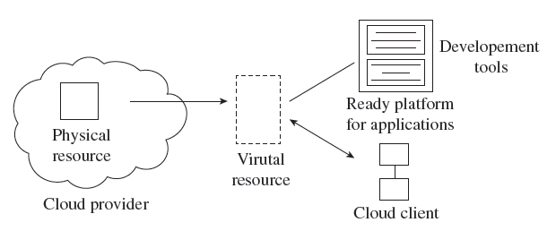
Platform as a Service
The following has to be performed in the PaaS:
Attain and install the server.
Organize the operating system, operate time settings, and source manage depository and other middleware to work efficiently.
Organize the operating system, operating time
settings, warehouse, and supplementary
middleware.
Copy data for further reference.
The best way to comprehend PaaS is to split it
separately into its major constituents—
service and platform.

Slide 11
Platform as a Service
Various Service Providers of PaaS
Terremark
Engine Yard
AT & T
Atlassian
PivotalLab
AppScale
Engine Yard
Flexiscale

Slide 12
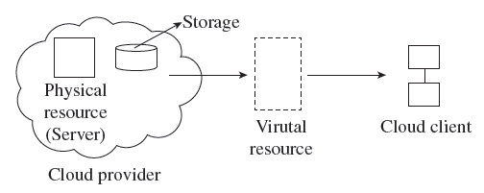
Infrastructure as a Service
Infrastructure as a Service (IaaS) is the delivery of computer infrastructure as a service.
National Institute of Standards and Technologies (NIST) defines cloud IaaS as follows:
“The capability provided to the consumer is to provision processing, storage, networks, and other fundamental computing resources where the consumer is able to deploy and run arbitrary software, which can include operating systems
and applications. The consumer does not manage or
control the underlying cloud infrastructure but has
control over operating systems, storage, and
deployed applications; and possibly limited control
of select networking components
(e.g., host firewalls)”.

Slide 13
Infrastructure as a Service
Amazon is the pioneer of IaaS. In India, IaaS providers include NetMagicSolutions and InstaCompute (from Tata Communications). The other leading providers are:
Rackspace
Joyent
Rightscale
Terremark
GoGrid
Elastic Hosts
Symetriq

Slide 14
Cloud Computing Sub Service Models
Everything as a Service (XaaS)
Compliance as a Service
Identity as a Service (IdaaS)
IaaS: DataBase as a Service (DBaaS)
Paas: Storage as a Service (STaaS)
Communications as a Service (CaaS)
SaaS: Security as a Service (SECaaS)
SaaS: Monitoring as a Service (MaaS)
PaaS: Desktop as a Service (DTaaS)
IaaS: Compute Capacity as a Service (CCaaS)

Slide 15
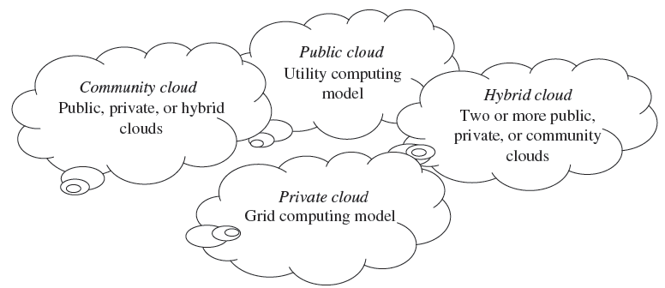
Cloud Deployment Models
The cloud model is invented with four deployment models—public cloud, private cloud, hybrid cloud, and community cloud.)

Slide 16
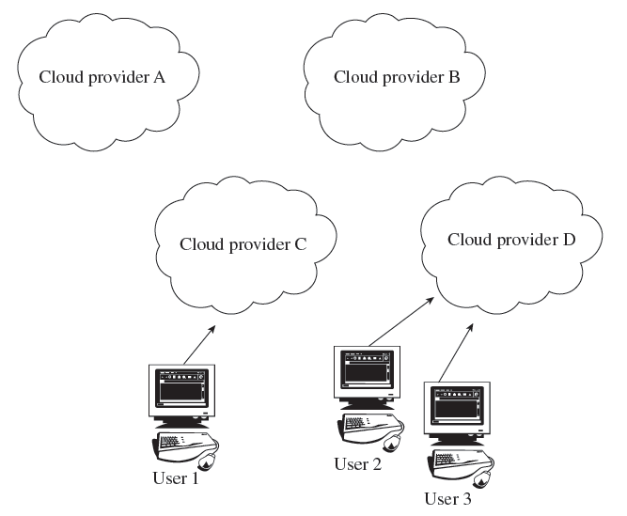
Public Clouds
The public cloud is the first deployment model. In this model, users have many options to opt for and decide on any service provider as per requirement.
Examples of public cloud vendors include
Google, Amazon Elastic Compute Cloud,
Windows Azure Services Platform,
Microsoft, etc.
This model assists in the reduction
of capital expenses and removes
equipped IT expenses.

Slide 17
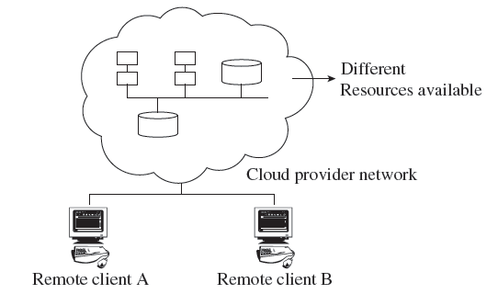
Private Clouds
The private cloud offers several advantages of an open cloud computing setting that comprises its service support and flexibility.
Private clouds allow infrastructure to be accessed only by the members of the organization and granted by third parties.
Examples of private cloud include Eucalyptus
cloud computing infrastructure with Ubuntu
Server, Elastra private-cloud, Vmware,
Microsoft, etc.

Slide 18
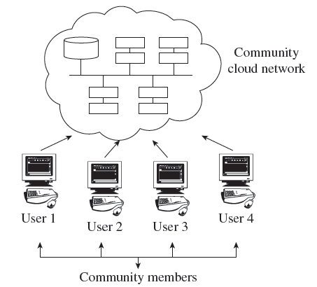
Community Clouds
A community cloud falls between public and private clouds category.
The drawback related to a community cloud is that of having costs higher than a public cloud.
Examples of community cloud include
Google’s ‘Gov Cloud’, NASA Nebula cloud,
etc.

Slide 19
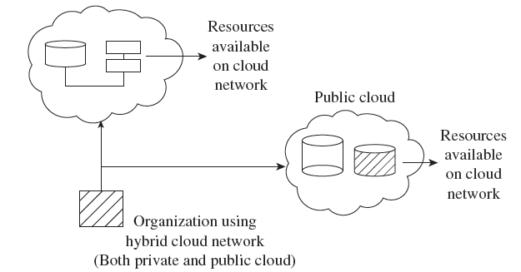
Hybrid Clouds
The hybrid cloud is a combination of a private and public cloud which is
mutually dependent on one another.
In this model, cloud users are supplied with information on the public cloud, in spite of the reality that the cloud supplier
has to maintain the company-significant
services and information in a few
instructions.

Slide 20
Alternative Deployment Models
Linthicum Model
Storage as a Service
Database as a Service
Information as a Service
Process as a Service
Application as a Service
Platform as a Service
Integration as a Service
Security as a Service
Management as a Service
Testing as a Service
Jericho Cloud Cube Model
Internal or external
Proprietary or open
Perimeterized or de-perimeterized architectures
Outsourced or insourced

Slide 21
CloudStack
CloudStack is cloud software which assists users to alter the cloud according to their requirements.
It controls and supports the network, storage, and compute joints in a cloud infrastructure.
It is used to arrange, control, and systematize situations in cloud computing.
With CloudStack, you are capable of the following:
1. Establishing an on-command, flexible cloud computing service. Service suppliers may offer self service virtual machines, networking arrangements, and storage sizes over the Internet.
2. CloudStack may be used to construct an on-command cloud computing service along with flexibility. Service supplier provides storage and virtual machines, and much more on the Internet.
3. An organization or worker could establish an on-premise private cloud along with CloudStack.

Slide 22
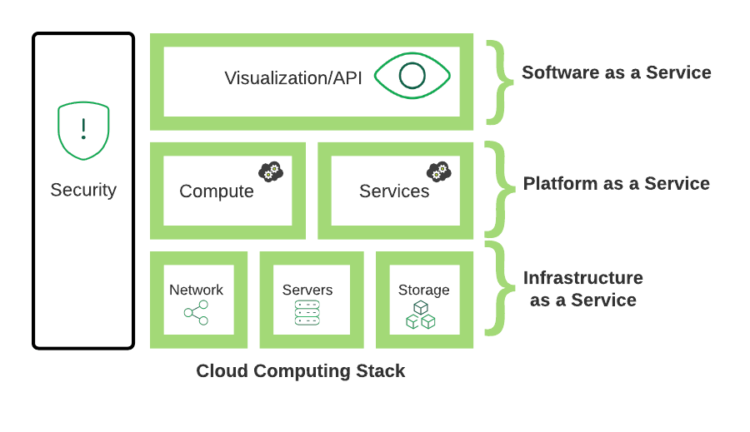
Cloud Computing Stack

Slide 23
Cloud Storage
Cloud storage is a service model wherein data is maintained, controlled, and backed up distantly and made accessible to users over a network (characteristically the Internet).
There are three major cloud storage models which are as follows:
1. Public cloud storage services, like Amazon’s Simple Storage Service (S3), offers a multi-occupant storage appropriate for data.
2. Private cloud storage services offer a dedicated storage restricted behind the firewall of a corporation. Private clouds are suitable for users who require customization and more power on their data.
3. Hybrid cloud storage is an amalgamation of the other two models, which comprise no less than a single public cloud and a single private cloud infrastructure. A corporation could, for instance, collect forcefully used and prepared data on a private cloud and sharable data on a public cloud.

Slide 24
Cloud Storage
Cloud storage is a module of networked online storage in which data is saved in virtualized groups of storage that are normally hosted by third parties.
Cloud storage services can be accessed via a web service application programming interface (API), or via a web-based user interface.

Slide 25
Thank You!

